Slide 1

Small business loan Approval Forecast

Slide 2

AGENDA
Overview of Problem
Overview of Datasets
Important findings from EDA
Baseline models and evaluation metrics
Next Steps

Slide 3

Overview of Problem
High-interest rate environment
Potential recession threat slower the rate cuts
Lack of access to traditional commercial banks
Proposed solutions and hope to build a model to help small businesses to have easier access to financing

Slide 4
Overview of Datasets
Lending club data 2007 to 2018
Only use the data related to Business use
Reduced rows from 2M to 20,000 rows.
Reduced columns from 150 columns to 21 columns
Convert categorical columns to numerical columns

Slide 5
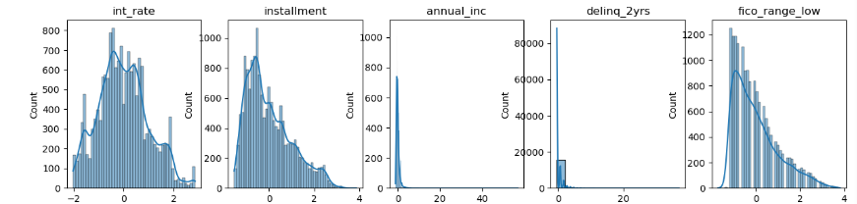
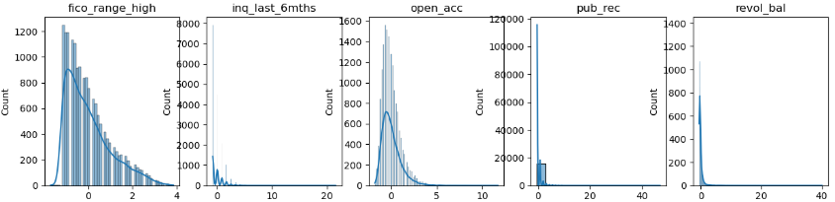
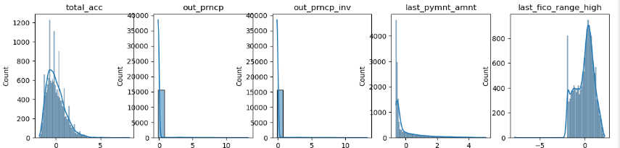
Overview of Datasets

Slide 6
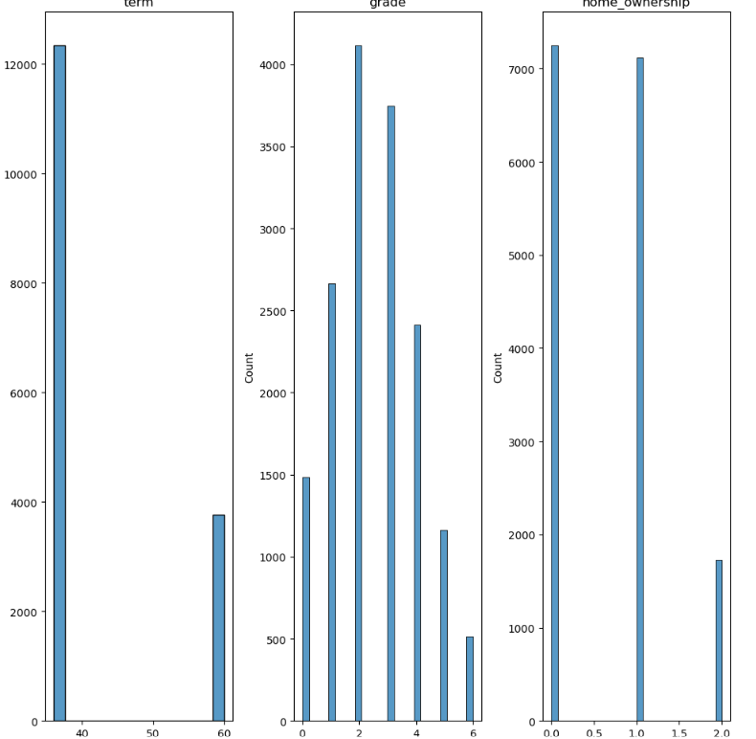
Overview of Datasets

Slide 7
Scaling and Building Models
ANN
Train Accuracy: 0.6784
Test Accuracy: 0.6798
Random Forecast Result
Accuracy Score: 0.9142857142857143
Confusion Matrix:
[[ 894, 137], # Class 0
[ 139, 2050]] # Class 1
For loan status equal to 1(fully paid), the model accuracy is 94%, and for loan status as default/ not fully paid, the model accuracy is 87%.

Slide 8

Next Steps
Inbalance class distributions(Class 1: 10925 vs. Class 0 : 5273)
Add industry specific risk for interest rates
Product Demo, i.e. a web tool to let lender to decide if the loan will default.

Slide 9

THANK YOU
Abigail Deng

